Slide 1
Sustainable Growth Strategy for Nykaa’s Beauty Segment
A Data-Driven Portfolio & Customer Analysis

Slide 2
Key Insights & Recommendations
Skincare and Makeup are top revenue-generating categories
High-Spending users buy from 3-5 categories and drive major value
Premium preference users make up only 23% of the base, but have higher spend
Offline stores lead in average spend, while apps bring the highest volume
Focus Ares: Premium tier growth, loyalty initiatives, cross-category bundling, and offline-online integration

Slide 3
Why This Analysis?
Nykaa has scaled rapidly but faces saturation in metro-centric digital growth.
Objective: Use customer and category data to uncover strategic growth levers in the beauty vertical.
Focus Area:
Product Category Performance
Customer Segmentation
Price Tier Patterns
Channel Strategy

Slide 4
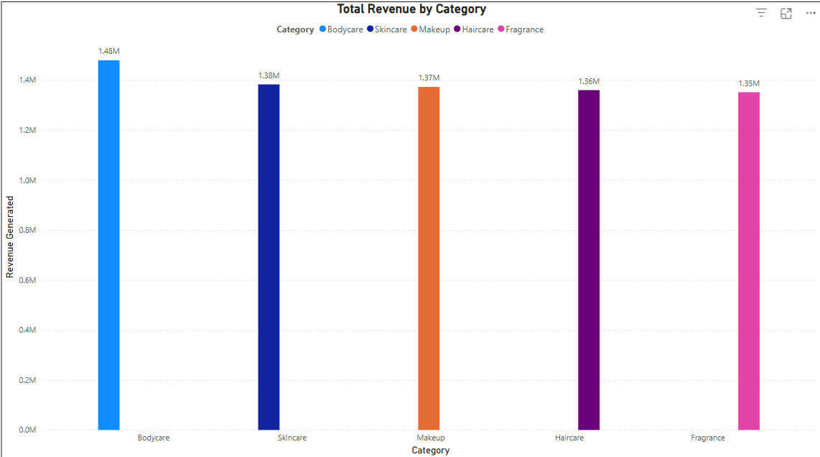
Where Nykaa’s Revenue Comes From
All Categories perform well, but BodyCare slightly edges out the rest
Revenue across categories is evenly distributed showing balanced portfolio.
Small shifts in marketing can tilt performance

Slide 5
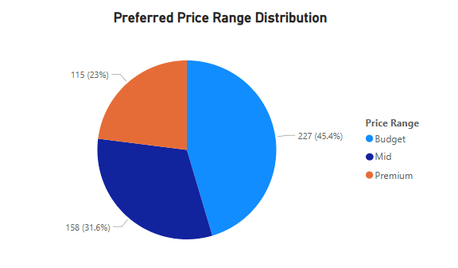
Who Are Nykaa’s Most Valuable Customers
While only 23% of users prefer premium products, they significantly outspend others, warranting a targeted premium strategy
A substantial 45% of users are budget conscious, can be nurtured to Mid-tier through gradual brand upgrades and starter bundle strategies

Slide 6
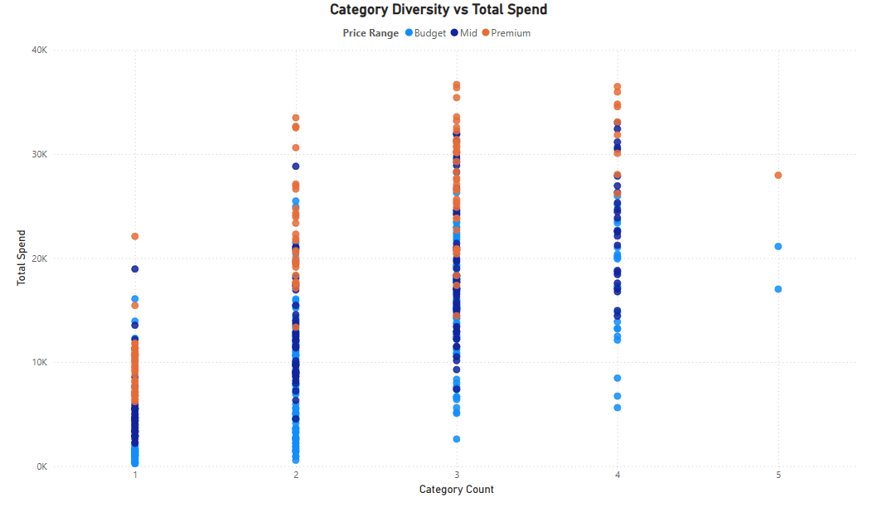
How Category Diversity Affects Customer Values
Users buying from 3-5 categories are high-value customers
Loyalty programs and bundles should target this group to maximize wallet share

Slide 7
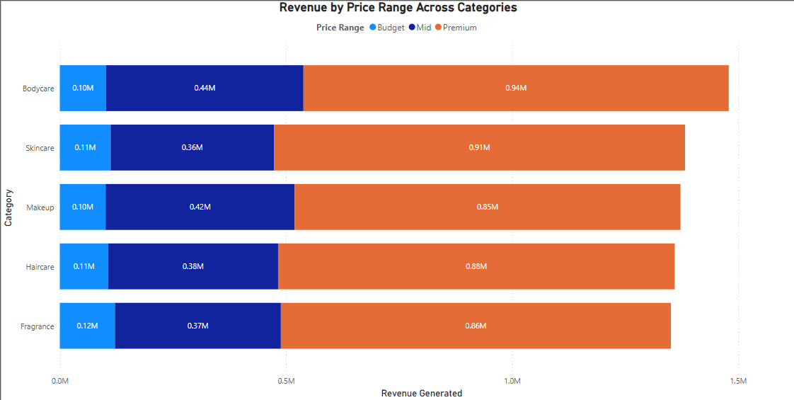
How Price Range Impacts Spending by Category
All Categories show dominant revenue from the Premium Tier.
Skincare & Makeup also show strong Mid-Tier contributions
Bodycare remains most Premium heavy

Slide 8
Which Channel Drives the Most Revenue
Channel | Total Revenue | Average Spend
Offline Store | ₹24.55L | ₹4,776
App | ₹23.17L | ₹4,690
Website | ₹21.74L | ₹4,646
Offline leads in average spend
Apps bring in the highest volume
Use omnichannel synergy to elevate retention

Slide 9
What This Means for Nykaa
Insights | Strategic Action
Premium Users = High Value | Exclusive SKUs, targeted ads, white-glove CX
Multi-Category users spend more | Cross-category bundles, rewards
Offline = High avg. order value | Expand store experience & loyalty sync
Budget-heavy user base | Entry-level SKUs that upgrade easily

Slide 10
4 Sustainable Growth Levers for Nykaa
Launch Refillable sustainable product lines for Mid & Premium segments
Introduce tiered loyalty program based on diversity and spend
Omnichannel integration: QR scans, unified offers, shared profits
Tier 2 / 3 influencer partnership to grow presence beyond metros

Slide 11
What’s Next?
Expand Framework to Fashion and Wellness Verticals
Track ROI of loyalty and Premium-focused campaigns
Monitor repeat purchase rate, GMV, and CAC/LTV
Build a Spend Elasticity Model - to test the impact of price changes on demand by tier
Customer Transition Matrix - forecast how users move Budget → Mid → Premium
Offline Premium Activation Plan - exclusive trials/events in high AOV cities

Slide 12
Thank You
“Where Customer Feel Seen, Loyalty Follows”

